Slide 1

Predicting Hype on StockX
Lead Analyst: Jake Moon

Slide 2
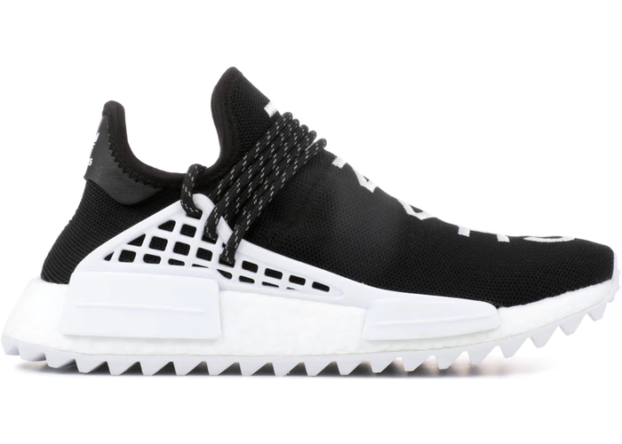
The Business Proposal
Invest in shoes from resellers
Undervalued shoes despite indicators
Use model to identify undervalued shoes
Upside on news, limited quantity, more time
Shoes < $1200 predictable
adidas Human Race NMD Pharrell x Chanel
Average Sale Price: $5,631

Slide 3
Why Should You Invest?
Sneaker resale is a $2 billion market
Projected to reach $6 billion by 2025
Sneaker resale website, StockX.com hits $1 billion valuation
Sell sneakers over retail price
Transparent, actionable data

Slide 4
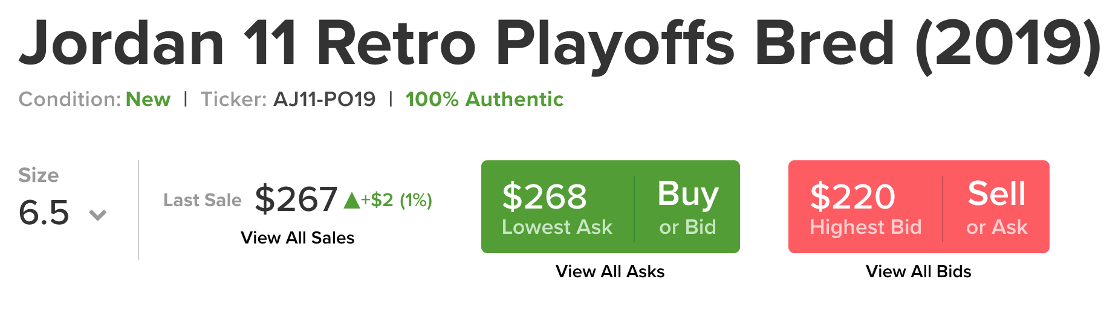
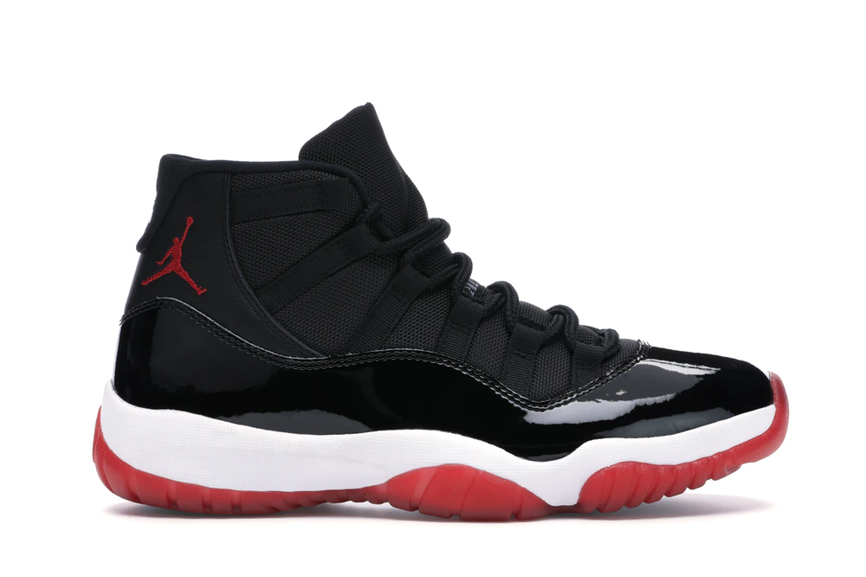
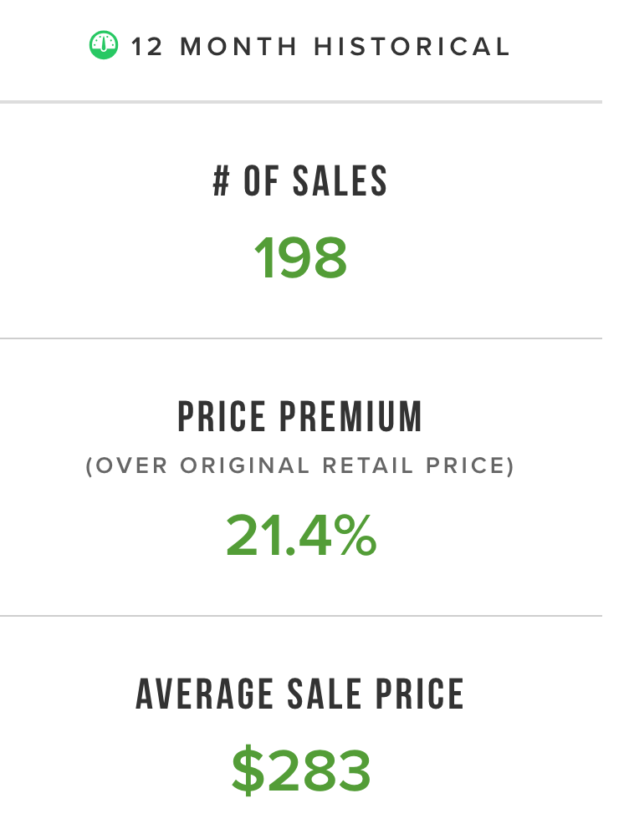
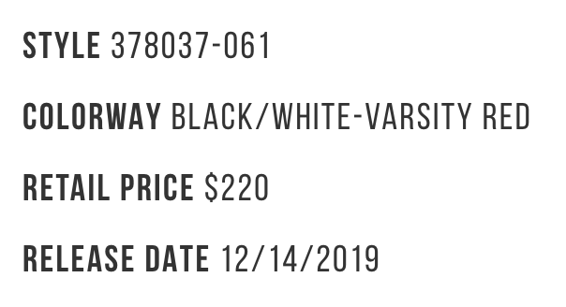
The Data
Scraped 2863 StockX pages
133 unique shoes (w/ different sizes)
Target: last sale price
Key features:
Size
Release date
Retail price
# sales
Volatility
Brand

Slide 5
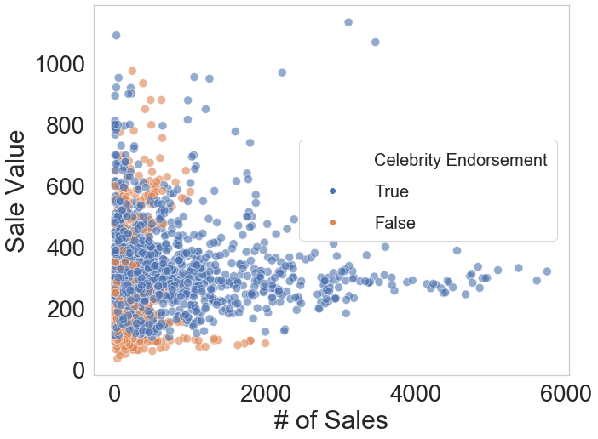
The Data Continued
Cleaned data
Removed extreme cases
Engineered features:
Celebrity endorsement
Travis Scott
Days since release
# of sales as proxy of supply and “hype”

Slide 6
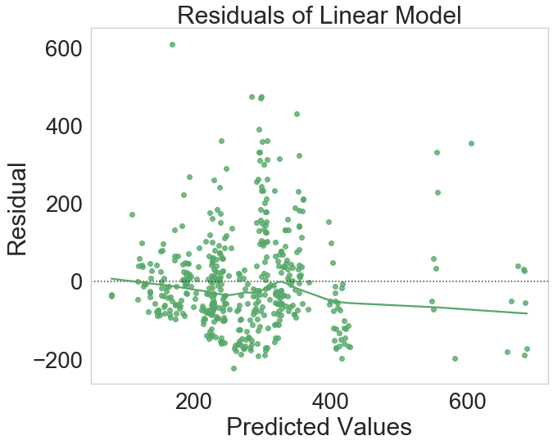
Initial Model
Linear model
Metrics:
Train R-sq (60%): 0.343
Test R-sq (20%): 0.346
Validation R-sq (20%): 0.335
Noisy at higher sale values

Slide 7
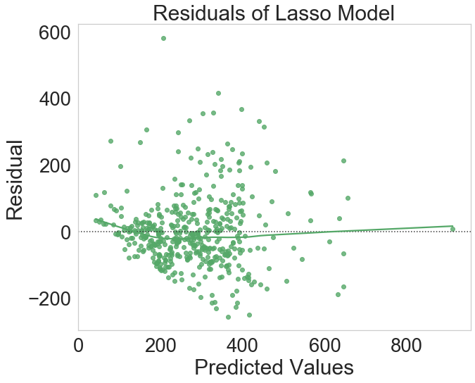
Final Model
2-degree polynomial
Lasso, α = 0.01
Interactions
Added size dummies
Metrics:
Train R-sq (60%): 0.575
Test R-sq (20%): 0.543
Validation R-sq (20%): 0.531

Slide 8
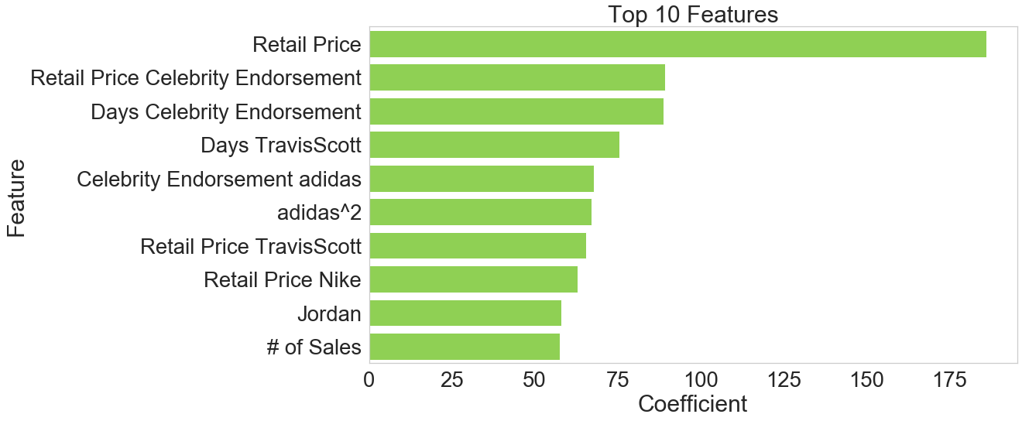
Notable Features

Slide 9
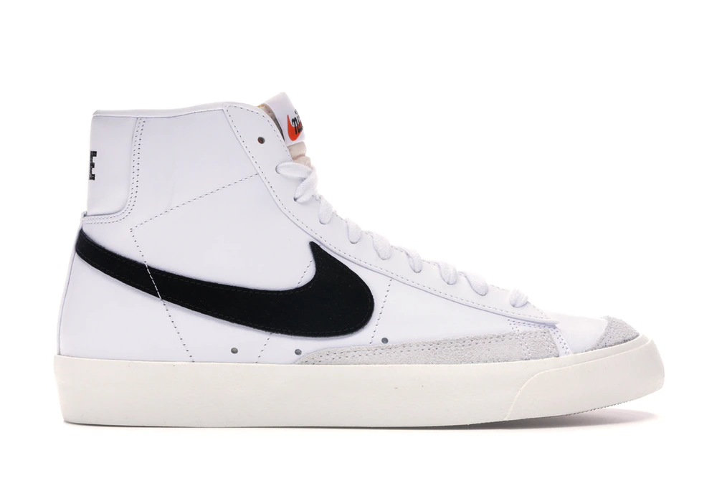
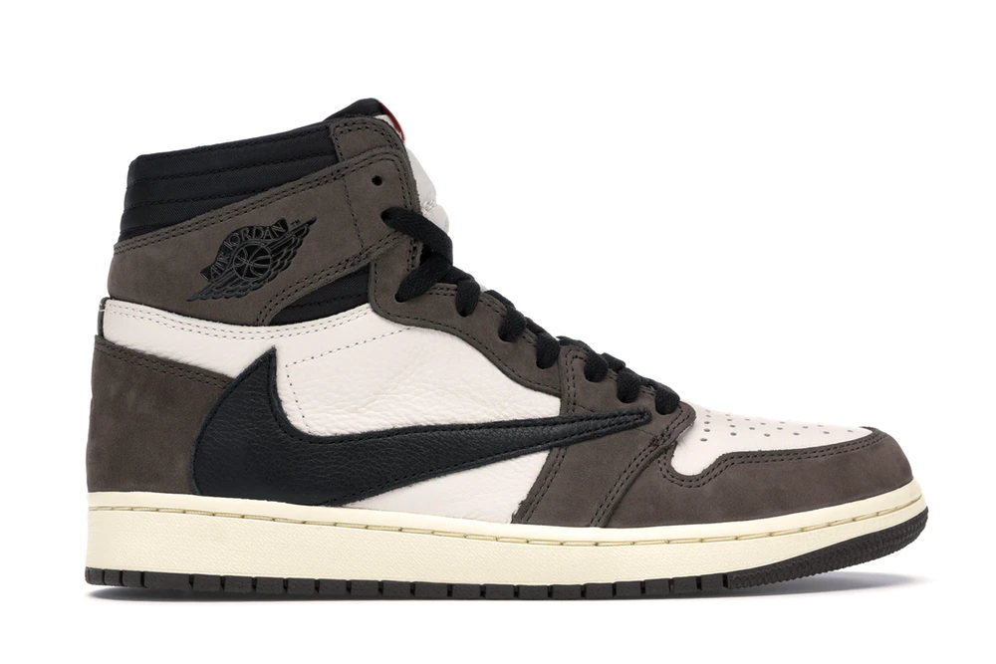
The Candidates
Name | Size | Last Sale Value | Predicted | Upside Potential
Nike Blazer Mid 77 Vintage White Black | 10.0 | $100 | $453 | $353
Jordan 1 Retro High Travis Scott | 15.0 | $720 | $1016 | $296
Nike Blazer Mid 77 Vintage White Black | 10.5 | $94 | $382 | $288
Nike Vapor Street Off-White Black Laser | 6.5 | $124 | $410 | $286
Nike Vapor Street Off-White Black Laser | 7.5 | $135 | $416 | $281

Slide 10
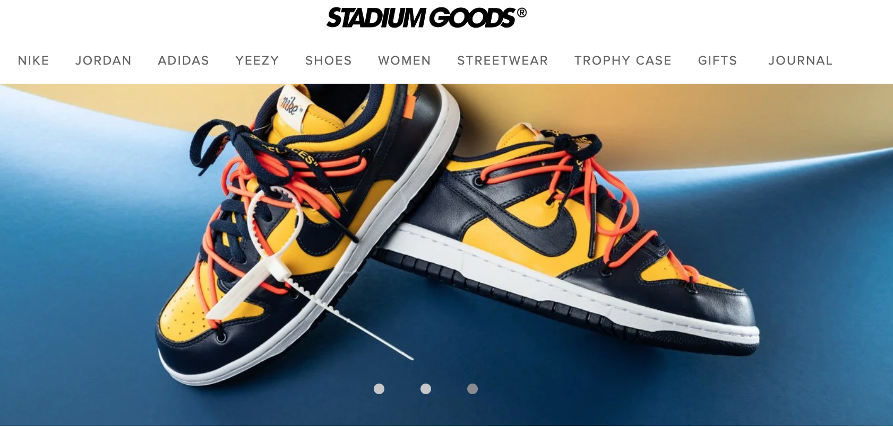



Improvements
Tree-based models can capture complex relationship of features
Time series of prices
More shoe data
Social media popularity
Pricing from other sites

Slide 11
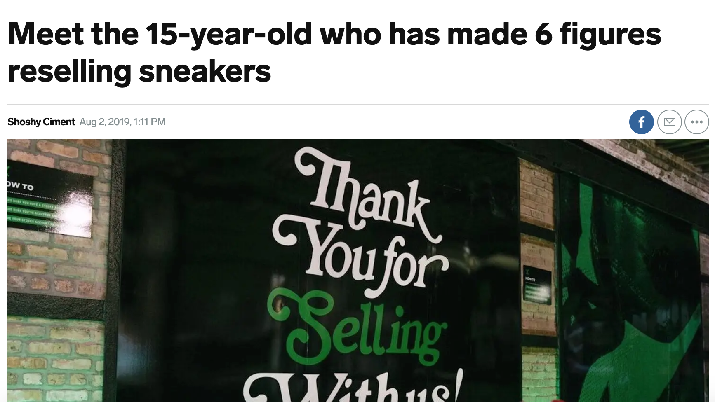
Questions?

Slide 12
Appendix
https://www.businessinsider.com/most-expensive-sneakers-sold-last-year-resale-2019-4
https://www.cnbc.com/2019/06/26/stockx-a-stock-exchange-for-sneakers-is-now-worth-1-billion.html
https://www.wsj.com/articles/stockx-hub-for-sneakerheads-is-latest-1-billion-unicorn-11561571959
https://www.stockx.com
https://www.businessinsider.com/teen-makes-money-selling-sneakers-stockx-2019-8

Slide 13
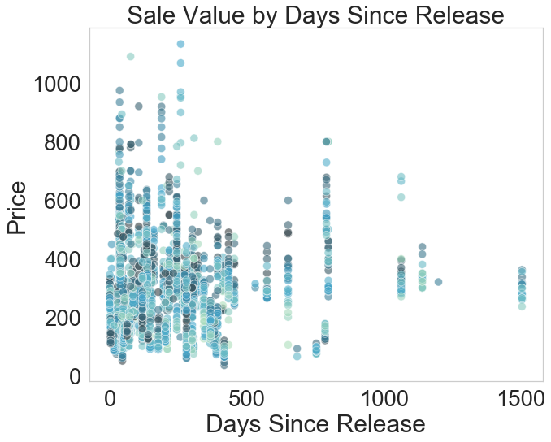
Appendix Continued

